Slide 1

Title: Cyclistic NYC Bike Usage Analysis
Subtitle: Analyzing bike-sharing trends across NYC borough-Bronx-Neighborhoods
Presented by: U DEKONTEE KUN, MSc.
Certificates:
Google Data Analytics
Google Business Intelligence Professional/Analyst
Date: December 2024

Slide 2


Agenda
Topics Covered:
Introduction (4 minutes)
Project Overview & Goals (5 minutes)
Data & Analysis Overview (10 minutes)
Breakdown of Bike Trips (2 minutes)
Map of Bike Stations (2 minutes)
Bike Usage by Age Group (2 minutes)
Peak Usage Hours (2 minutes)
Recommendations (3 minutes)
Actionable Steps (3 minutes)
Questions (5 minutes)

Slide 3


Introduction
Cyclitic: is a bike-sharing program in NYC that allows users to rent bikes for short trips.
The goal of this analysis is to provide data-driven insights into bike usage trends.
The study focuses on factors like trip by user types, trip durations, peak hours, trip by zip codes, trip by gender, age group and station usage to optimize operations.

Slide 4
Project Overview & Goal
Problem Statement: Cyclitic wants to analyze bike usage trends to optimize operations and marketing strategies.
Objective: Identify key insights on customer behavior, usage patterns, and areas for improvement.
Business Impact: Understanding these trends can improve resource allocation, infrastructure planning, and customer engagement.

Slide 5
Data & Analysis Overview
Data Sources:
NYC_BIKE_2013 dataset (Bike trip data)
Cyclistic NYC Zip Codes dataset (Borough & neighborhood mapping)
ETL (Extract, Transform, Load) Process:
Extract: Collected raw bike trip data from the NYC_BIKE_2013 dataset.
Transform:
Removed duplicates & missing values
Standardized gender labels
Merged datasets based on ZIP codes
Load: Cleaned and structured data was imported into Tableau for visualization.
Tools Used:
MySQL for data processing and ETL pipeline execution
Tableau for visualization and analysis

Slide 6
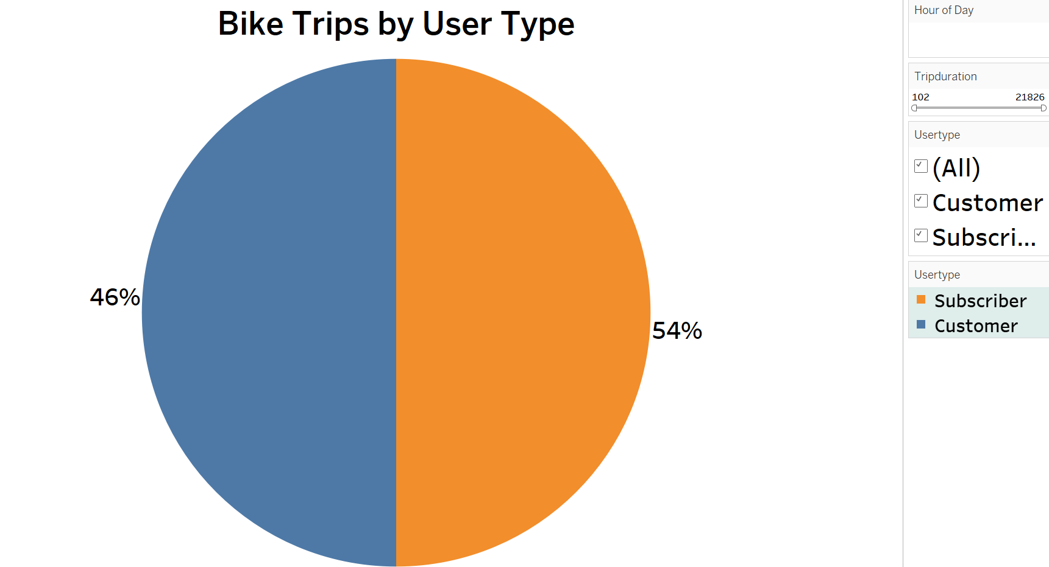
Bike Trips by User Type
Key Takeaways:
Subscribers make up 54% of all trips, while Casual Riders account for 46%.
Targeted marketing strategies could help convert casual users into subscribers.

Slide 7
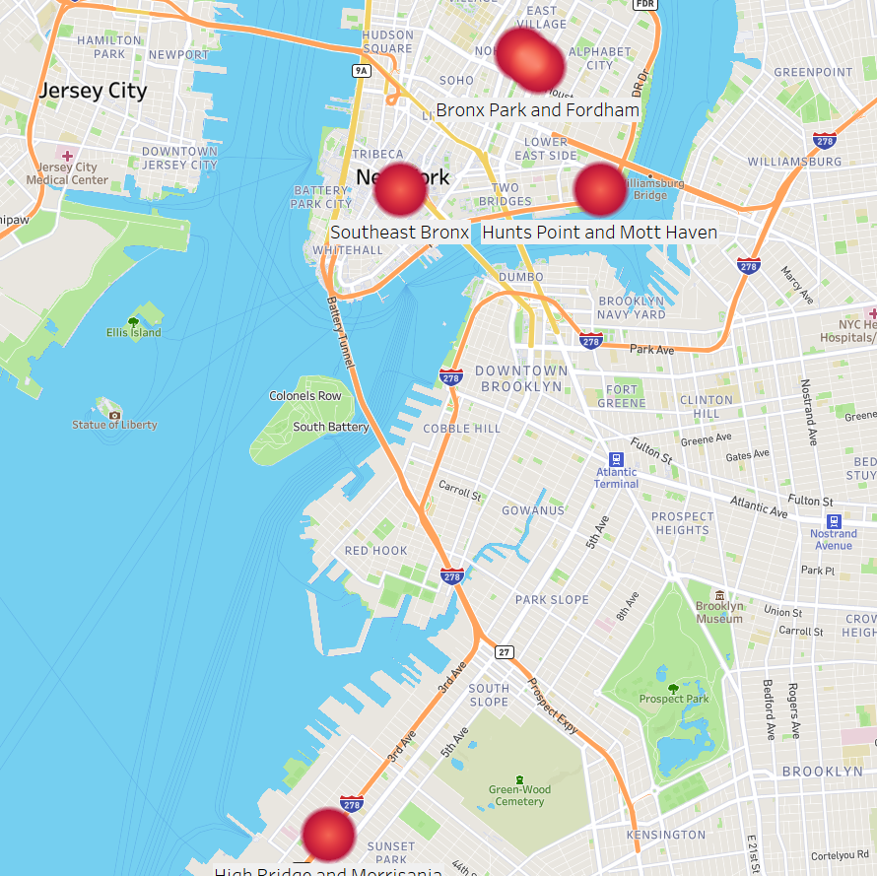
Map of Bike Stations
Key Takeaways:
Bike stations are concentrated in high-traffic areas.
Opportunities exist to expand stations in underrepresented locations.

Slide 8
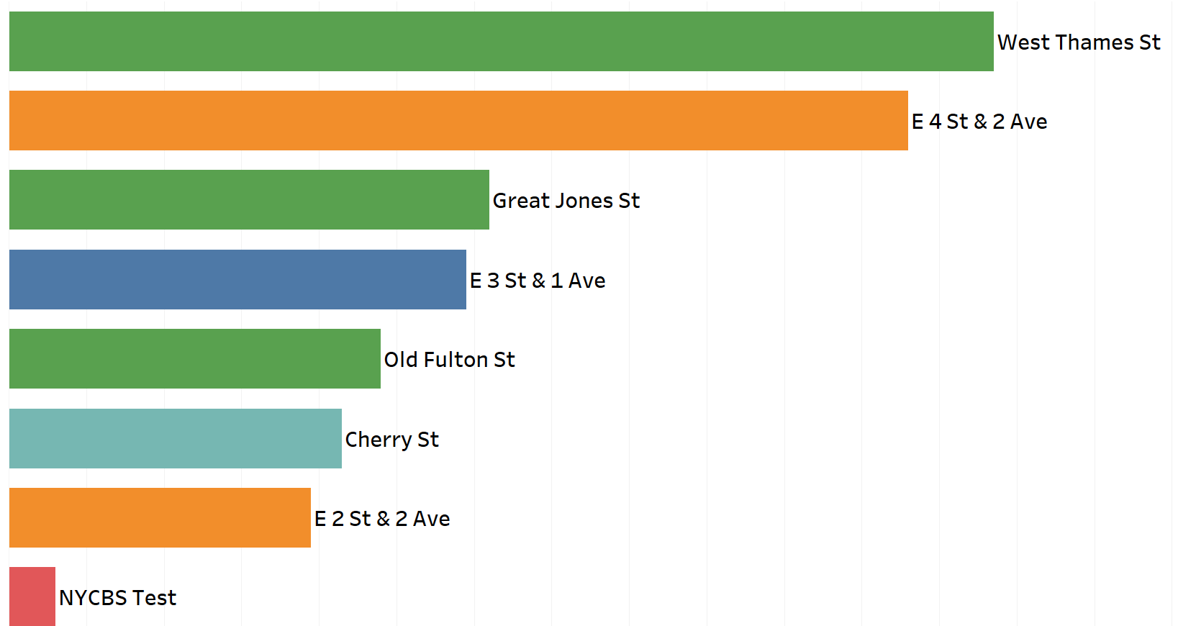
Most Popular Start & End Stations
Key Takeaways:
Certain stations see significantly higher traffic than others.
High-traffic stations need better bike availability.

Slide 9
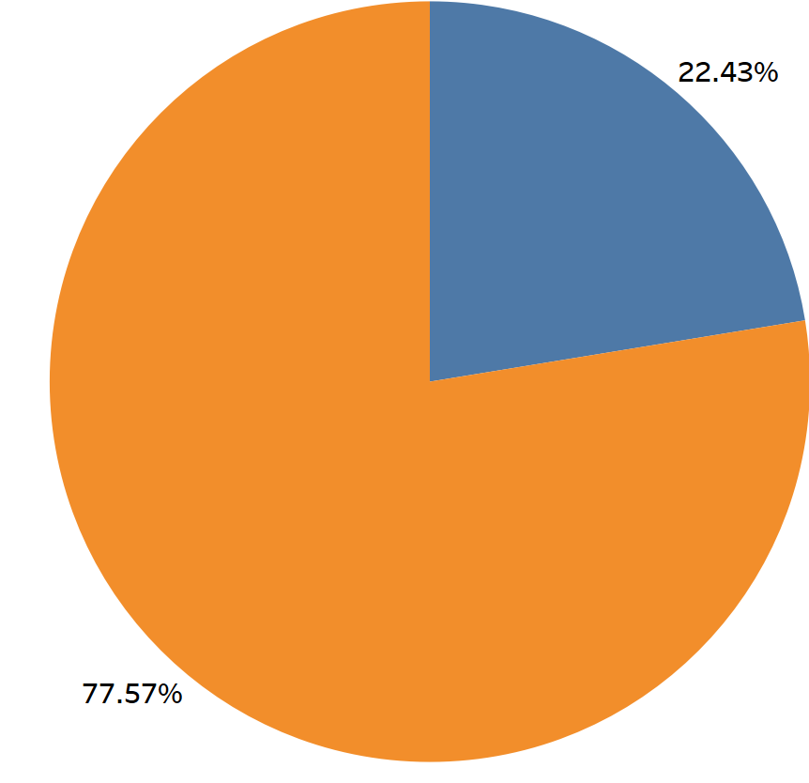
Gender Breakdown of Bike Trips
Key Takeaways:
Male riders account for 65% of trips, while Female riders make up 35%.
Marketing strategies could focus on increasing female ridership.

Slide 10
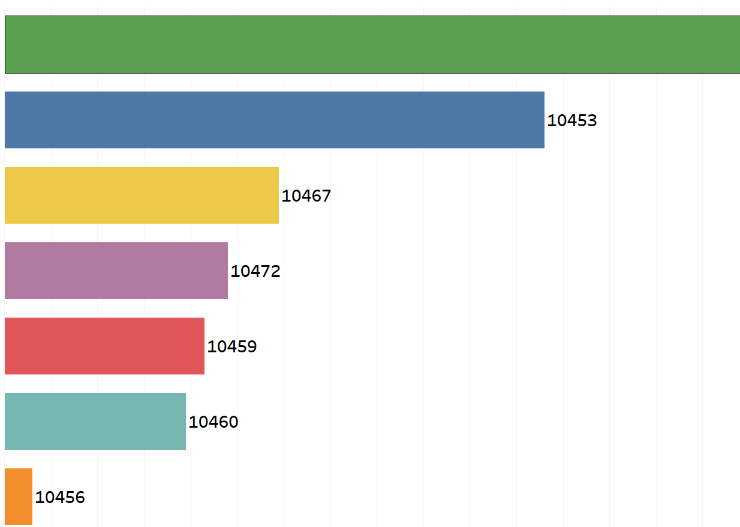
Total Bike Trips by Zip Code
Key Takeaways:
Some ZIP codes have much higher trip volumes.
Understanding demand by location can help optimize station placement.

Slide 11
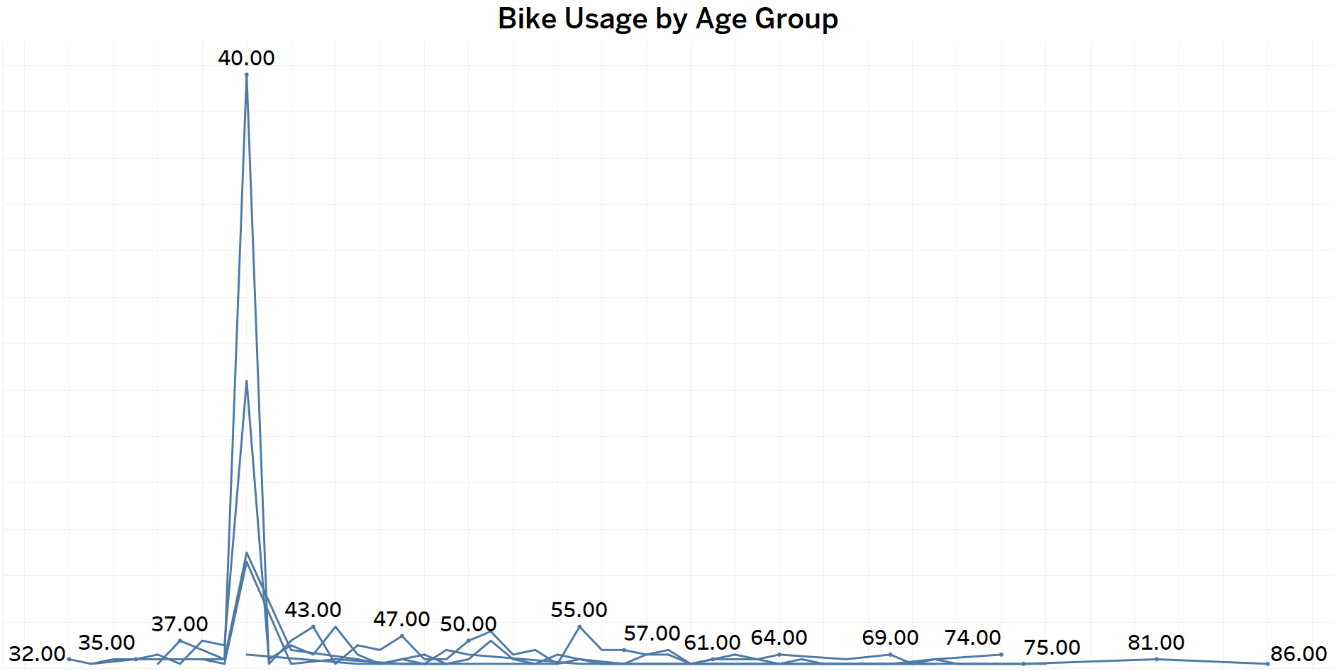
Bike Usage by Age Group
Key Takeaways:
Most riders are between 25+ -50+ years old.
Younger riders (under 25) and older users (50+) have lower engagement.
Marketing strategies could target age-specific promotions.

Slide 12
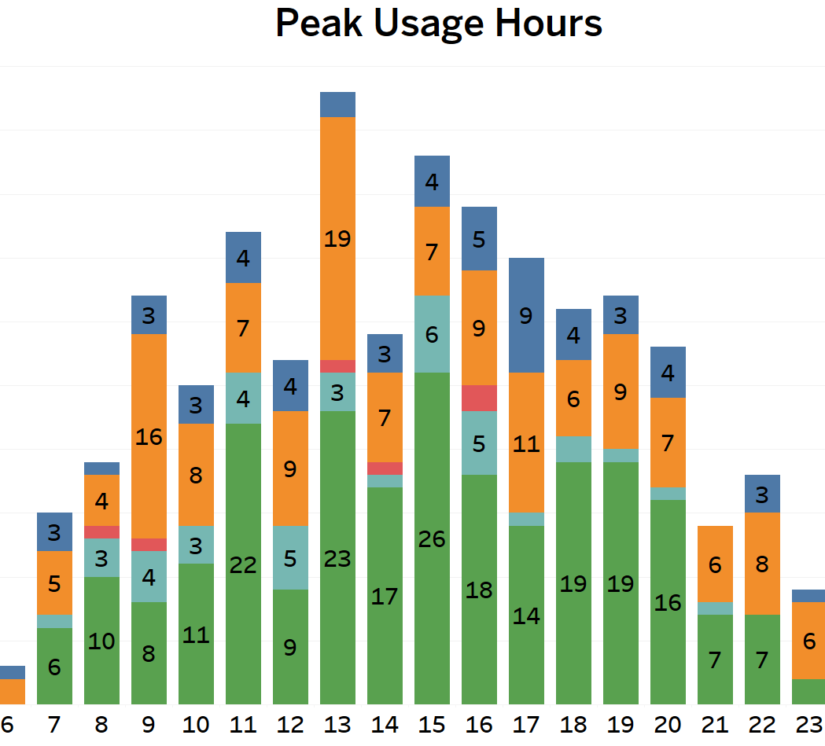
Peak Usage Hours
Key Takeaways:
Peak hours align with commuter times (7-9 AM & 5-7 PM).
Potential for promotional pricing during off-peak hours to increase usage.

Slide 13
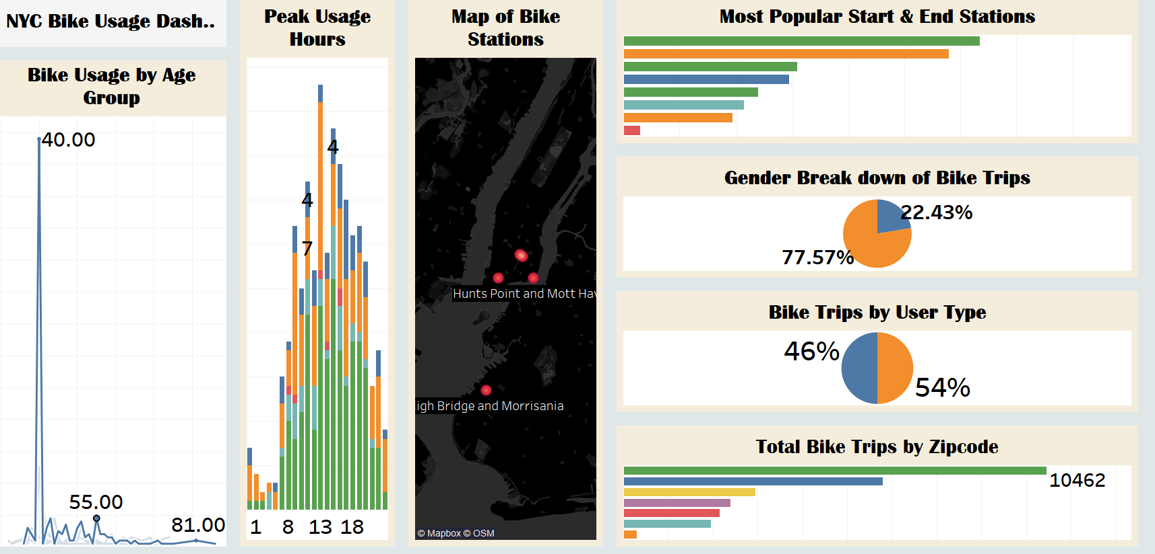
Dashboard
DASHBOARD

Slide 14

Key Insights from Data
Bike Usage by Age Group:
South-east Bronx accounts age 40s for many bike trips in the dataset.
User Type Breakdown:
54% of users are Subscribers; 46% are Casual Customers.
Gender Distribution:
Male riders make up 65% of trips; Female riders 35%.
Peak Usage Hours:
Most trips occur between 7 AM - 9 AM and 5 PM - 7 PM (commuter hours).
Trip Duration Trends:
The average trip duration is 15-20 minutes.

Slide 15
Recommendations
Expand
Expand Bike Stations in High-Demand Areas
Focus on
Focus on high-traffic Bronx locations & potential Manhattan growth.
Develop
Develop Targeted Marketing for Casual Users
Convert
Convert occasional riders to subscribers with discounts & loyalty programs.
Optimize
Optimize Bike Availability During Peak Hours
Increase
Increase bike rebalancing efforts at peak times.

Slide 16

Actionable Steps
Conduct further research on underserved locations.
1
Launch marketing campaigns for casual riders.
2
Improve bike rebalancing logistics during peak hours.
3
Monitor impact of changes and refine strategies accordingly.
4

Slide 17

Questions
Any questions?
Thank you for your time!
Contact: udekontee@gmail.com

